Slide 1
Hiring Process Analytics
EXCEL SHEET:
https://docs.google.com/spreadsheets/d/1Rigty5PnSxKznv77CWylTwbbbRNtDMrG/edit?usp=drive_link&ouid=111667124296828215097&rtpof=true&sd=true
VICTOR SHAH

Slide 2
Project Description
As a data analyst in a multinational company like Google, my primary responsibility is about analyzing the company’s hiring process data and draw meaningful insights from it.
The aspect of my role is to extract meaningful insights from the dataset. These insights will offer actionable information for various teams within the business.
The hiring process is a crucial function of any company, and understanding trends such as the number of rejections, interviews, job types, and vacancies can provide valuable insights for the hiring department.
The goal is to empower the product manager and the entire team with actionable insights that will shape the future development and user experience in the application.

Slide 3
Approach
Downloading the Dataset: The first step is downloading the excel file (.csv) into the local device.
Understanding the Worksheet: The next step is to examine the structure of the table holding the data in the Excel sheet. (statistics.csv)
Identifying the key tables: Identification of the primary key from the dataset of Statistics.
Checking for null values: Before the analysis, it is necessary to check for null values in the given tables.
Clubbing Columns: If there are columns with multiple categories that can be combined, they are then clubbed together to simplify the analysis.
Outlier Detection: Checking for outliers is a must as they affect or skew the analysis.
Visually Appealing: The Excel worksheet should be properly formatted so that it can by understood any user.

Slide 4
Data Analytics Tasks

Slide 5
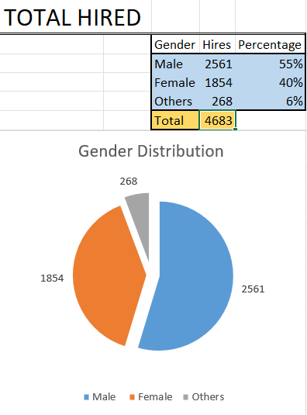
A. Hiring Analysis
Determine the gender distribution of hires. How many males and females have been hired by the company?
There are a total of 4082 male hires and 2673 female hires in the company.

Slide 6

B. Salary Analysis
What is the average salary offered by this company?
The average after removing the outliers comes out to be 49881.14.
In this case the salary offered by both hired and rejected are considered.

Slide 7
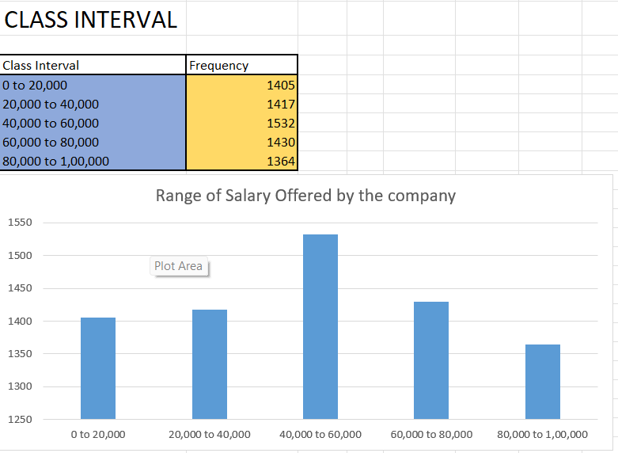
C. Salary Distribution
Create class intervals for the salaries in the company. This will help you understand the salary distribution.
There is the spike in salary offered between 40,000 and 60,000 in the company

Slide 8
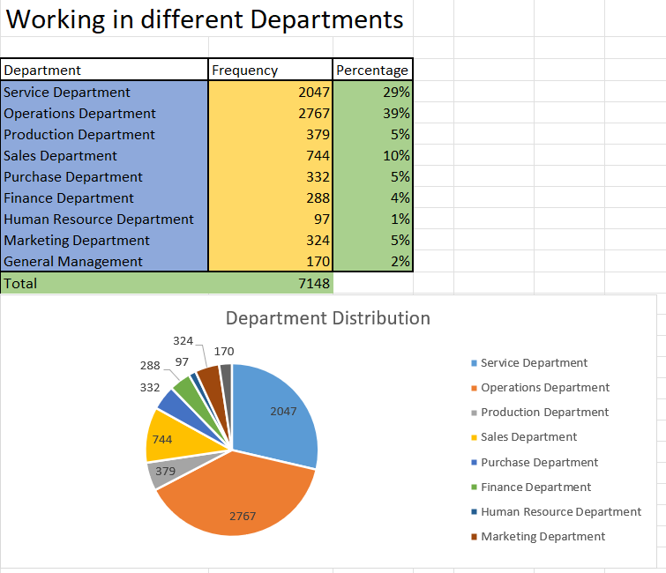
D. Departmental Analysis
Use any suitable visualization to show the proportion of people working in different departments.
The proportion of people working the most is in the Operations Department.

Slide 9
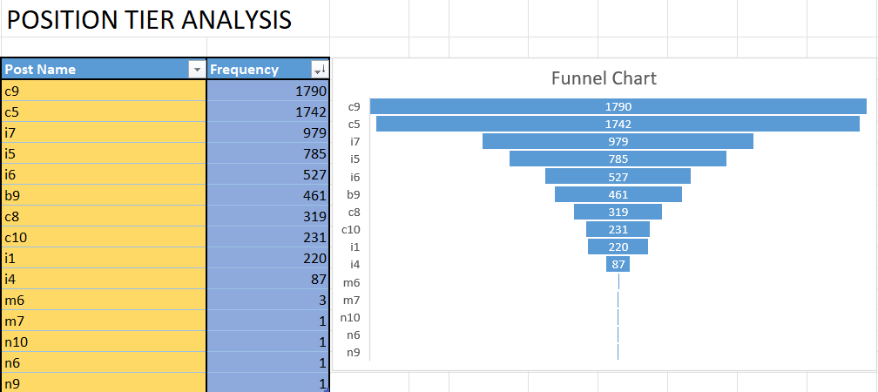
E. Position Tier Analysis
Use any visual to represent the different position tiers within the company.
The proportion of people working the most post is in the C9 Post.

Slide 10
Tech-Stack Used
Microsoft Excel: It is a spreadsheet program from Microsoft and a component of its Office product for business applications. MS Excel enables users to format, organize and calculate data in a spreadsheet.
MS Excel Functions: They are predefined formulas that perform calculations by using specific values, called arguments, in a particular order, or structure. Functions can be used to perform simple or complex calculations. Some of the functions are:
Text functions: clean(), substitute(), replace(), concatenate(), trim(), search(), find(), textjoin(), etc.
Mathematical and Statistical functions: sum(), sumif(), count(), countif(), round(), avg(), min(), max(), subtotal(), etc.
Date time functions: today(), now(), days(), month(), time(), hour(), etc.
Logical functions: and(), not(), or(), xor(), if(), etc.
Data Visualization in Excel: Bar, column, line, histogram, pie, scatter, boxplot, treemap, etc.

Slide 11
Insights
We were able to determine the gender distribution of hires within the company.
We were able to find out the average salary offered to applicants in the company holding both the hired and rejected applicants.
The salary distribution was differentiated using class intervals. Through which it was clear what the maximum range of salary was offered by the company.
Visualizing the data through charts to find out the maximum number of hires in the which department.
Figuring out the different positions within the company having different tiers or levels.

Slide 12
Result
Remembering to adapt the excel functions on specific datasets.
These learned insights helped me understand specific business questions which were addressed by MS Excel.
Learning about Excel Text and Statistical functions. The importance of max() and min() functions.
We were able to build different charts for visualization for answering the business questions. Some of the charts were pie chart, bar chart and funnel chart.
Achieving the ability to learn and write MS Excel functions to execute different business questions.
Solving company related problems using different visualization charts offered by MS Excel.

Slide 13




Thank you

